Slide 1
Collection and SOQL Assignment

Slide 2
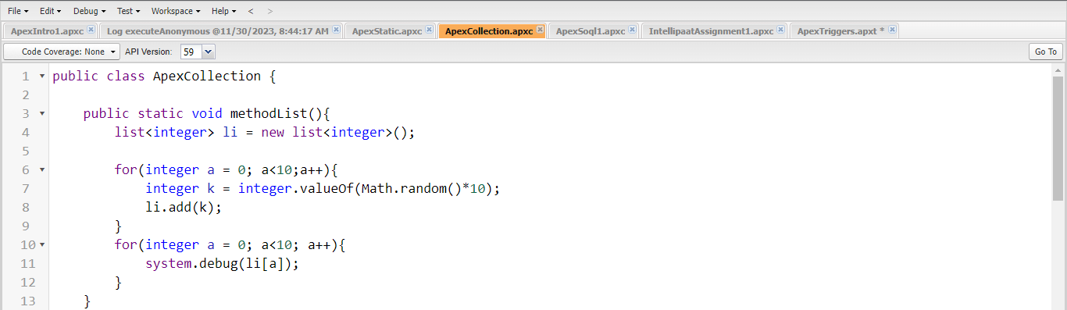
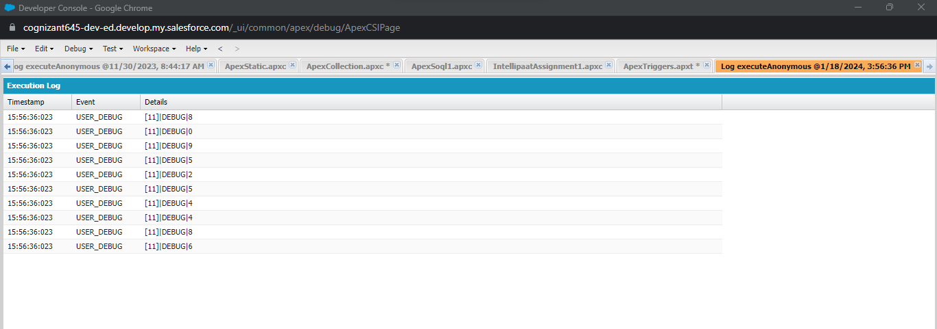
1)
Add the values to the list
Retrieve the values from list using index

Slide 3
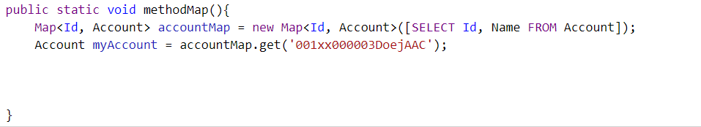
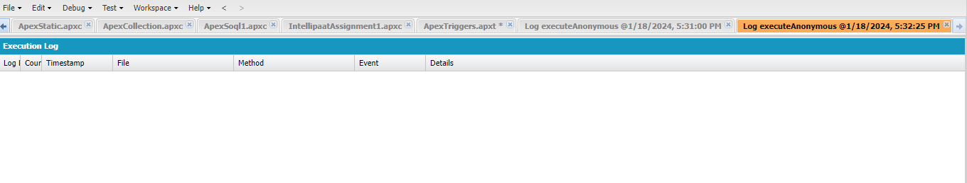
2)
Create a map of account id and account objects.

Slide 4
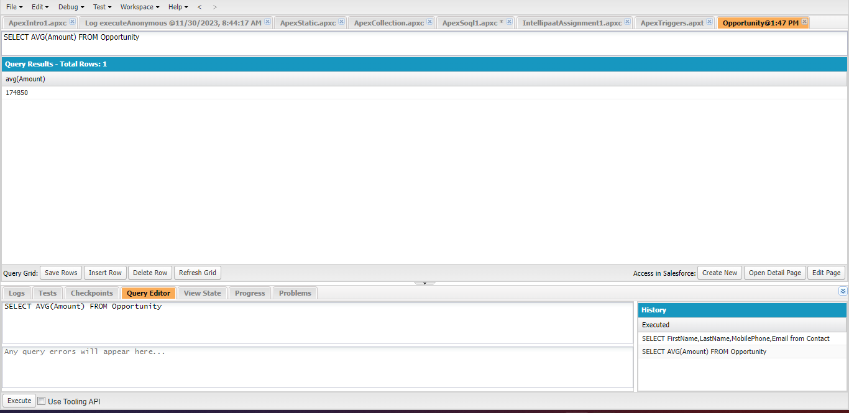
3)
Write an example of aggregate function without using GROUP BY clause.

Slide 5
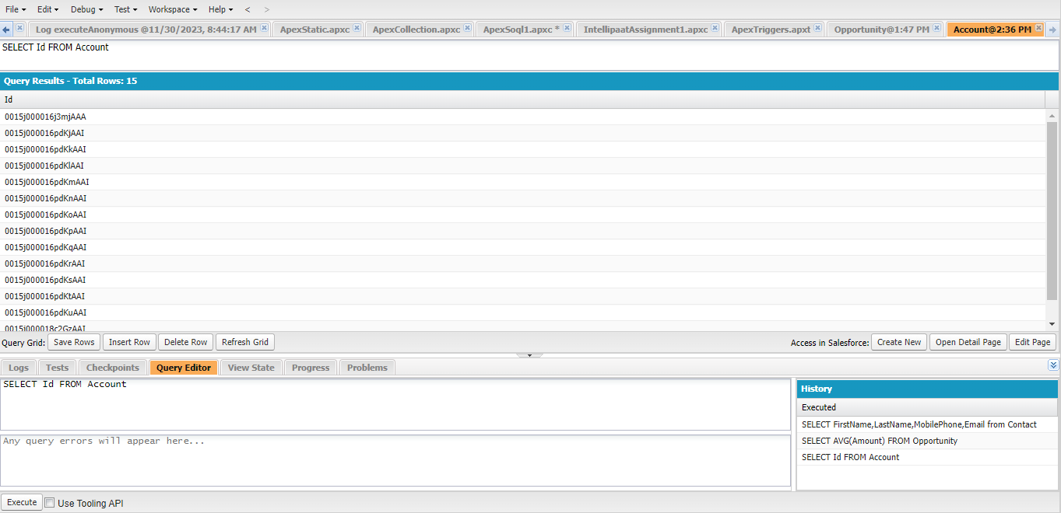
Write an example of SOQL Query that return one record

Slide 6
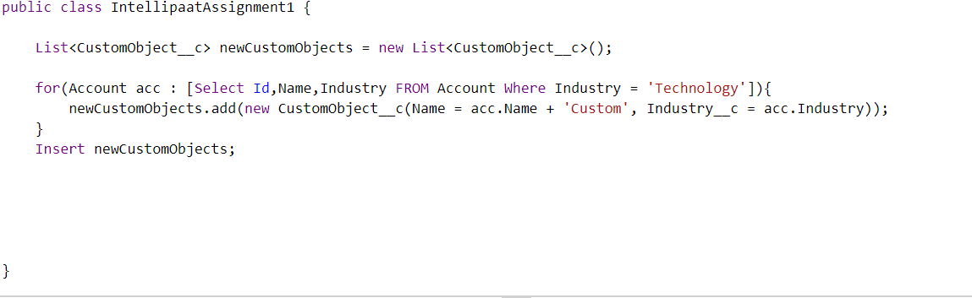
Create a new object using SOQL on existing ones

